Slide 1


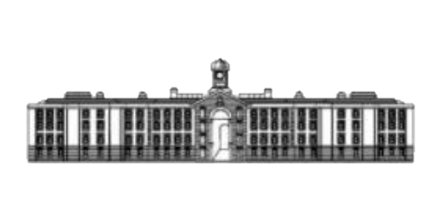
Irish Artisans
Marketplace for Local Artisans Android Mobile Application
GRIFFITH COLLEGE

Slide 2
Problem Definition
Local Artisans having problems to gain recognition beside the people of close contact.
Offline trading can cover only small area with people of potential interest.
Selling hand made crafted products over online POS system much convenient than offline retail places.
Availability of sale 24/7 and potential no limitation in area of reach.
Quicker and easier communication and feedback with customers.
In Ireland most artisan are having representation online over social media such is Instagram, or having own website as a blog.
90% of adult population in Ireland is using smartphones to reach internet, 62% of such devices are Android based.

Slide 3
Project Goal
Through the research of the: - Trading of handmade products
- Online Point Of Sale systems
- Mobile Development
Develop Android Mobile Application that:
- empowers local art and craft makers as digital platforms to sale their hand-made products globally,
- supports community engagement
Project Scope
The Android based Mobile Application for pleasant usage by general public, with ability to purchase unique hand-made products and gather artisans as direct sellers of they products, and for craft makers to exchange of they experience with others in area of Limerick Ireland.

Slide 4
Project Objectives
- Perform preliminary research on hand-made product marketplaces
- Perform Primary research by using the Mixed Research methodology, combine Quantitative and Qualitative researches respectively.
- Perform comprehensive literature review on historical and current perspectives on the topic and Case studies of similar, existing mobile application.
- Structure System Requirements in Conceptual Models for the proposed mobile application, generate alternative solutions.
- Design, Code and Test a prototype of the proposed application.
- Perform User Evaluation, analyse results and apply user`s feedback if necessary
- Complete Thesis and present the Project

Slide 5
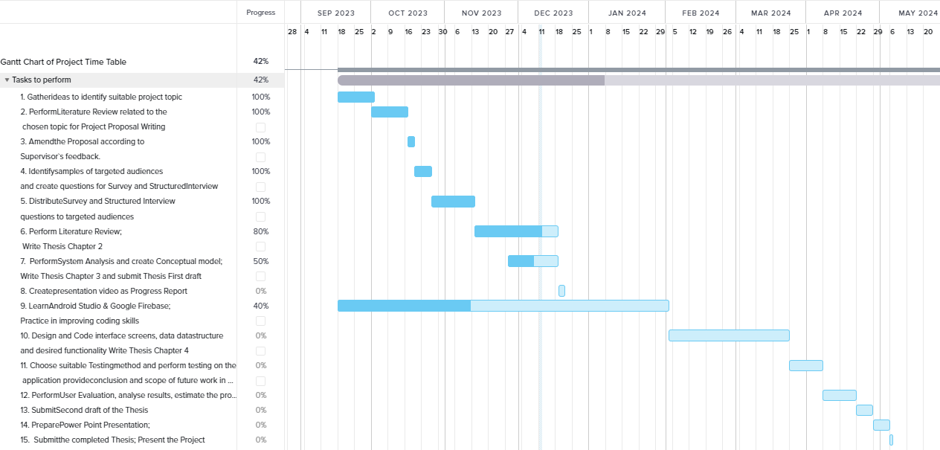
Project Gantt Chart

Slide 6
Topic Research Historical Perspective
- Trading products is one of the main way of communication in human behave.
First record of trading products was recognised around 3000 BC.
Places where people can purchase various type of products that might suit for every customer was existed from 16 centaury. (Bosh, 2023)
- Marketplaces are models that represents economic and social systems in a way how it is currently are – free market, stock market, black market ets. (Brady, 2020)
- Industrial revolution separates market more to mass production and low quantity production. However it`s not cancelled the demand for specially designed and crafted things and over time human interest of such of products only increased. (Renauld, 2023)
- Within new technologies availability of hand made products increases together with offer options. (Smith, 2015)
- First e-Commerce platform was released in 1979 by CopuServe. (BigCommerce)
- Online marketplaces is same e-Commerce platform but self maintaining where all transaction are managed by themselves. First Online marketplaces are E-bay and Amazon. (Mitchell, 2022)

Slide 7
Topic Research Current perspective
-Trading hand made products within achieving success in 2023 required many elements of business to count. Branding, marketing and business plan. (Aheme, 2023)
- On 2020 Ireland had 105,000 people that are involved into Craft and Design
Sector within economical contribution of 3.6 billions Eur. (Design and Craft
Council Ireland, 2021).
- Covid-19 placed small businesses in difficult position where most of
them have been moved digital. That increased value of marketplaces
tremendously. (Kovalchuk, 2021)
- Social media is become main platform for Artisans – ease to reach
potential clients, create mouth of words to gain reputation
(Au, Authony 2016)
Sr. No | Retail website | Millions
1 | Amazon.com | 4059M
2 | Ebay.com | 1227M
3 | Rakuten.co.jp | 804M
4 | Samsung.com | 648M
5 | Walmart.com | 614M
6 | Apple.com | 562M
7 | Aliexpress.com | 532M
8 | Etsy.com | 395M
9 | Homedepot.com | 292M
10 | Allegro.pl | 272M

Slide 8
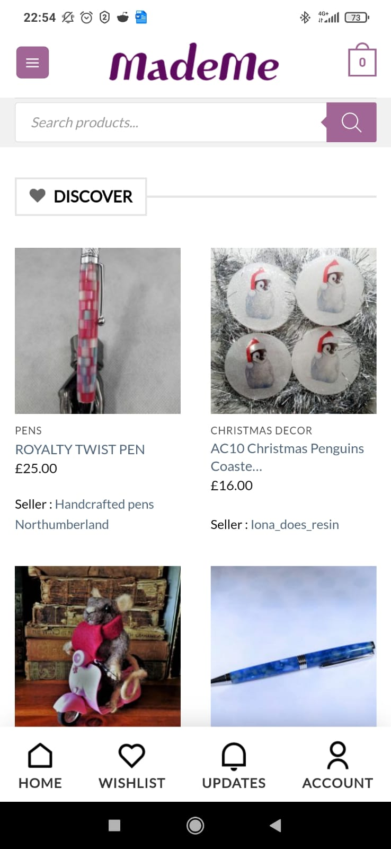
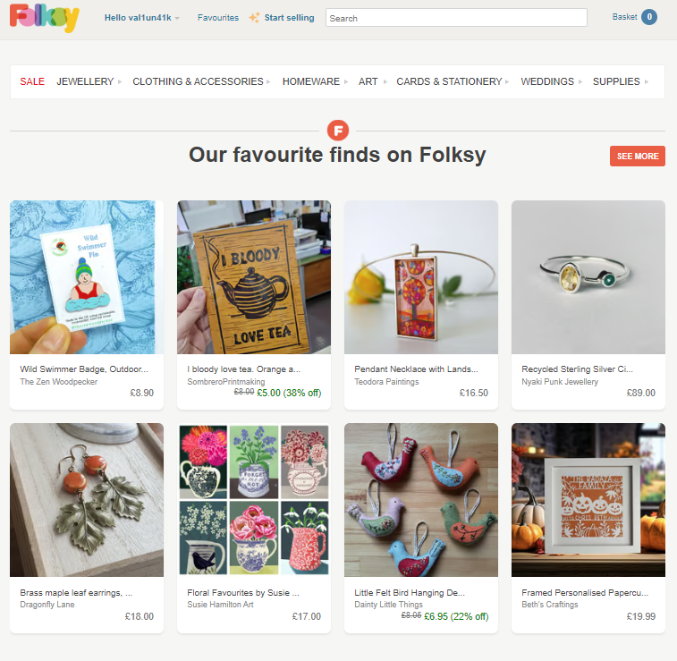
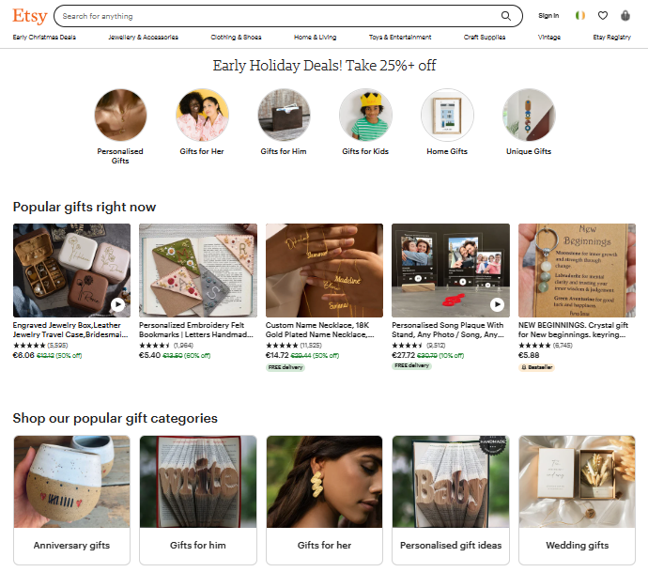
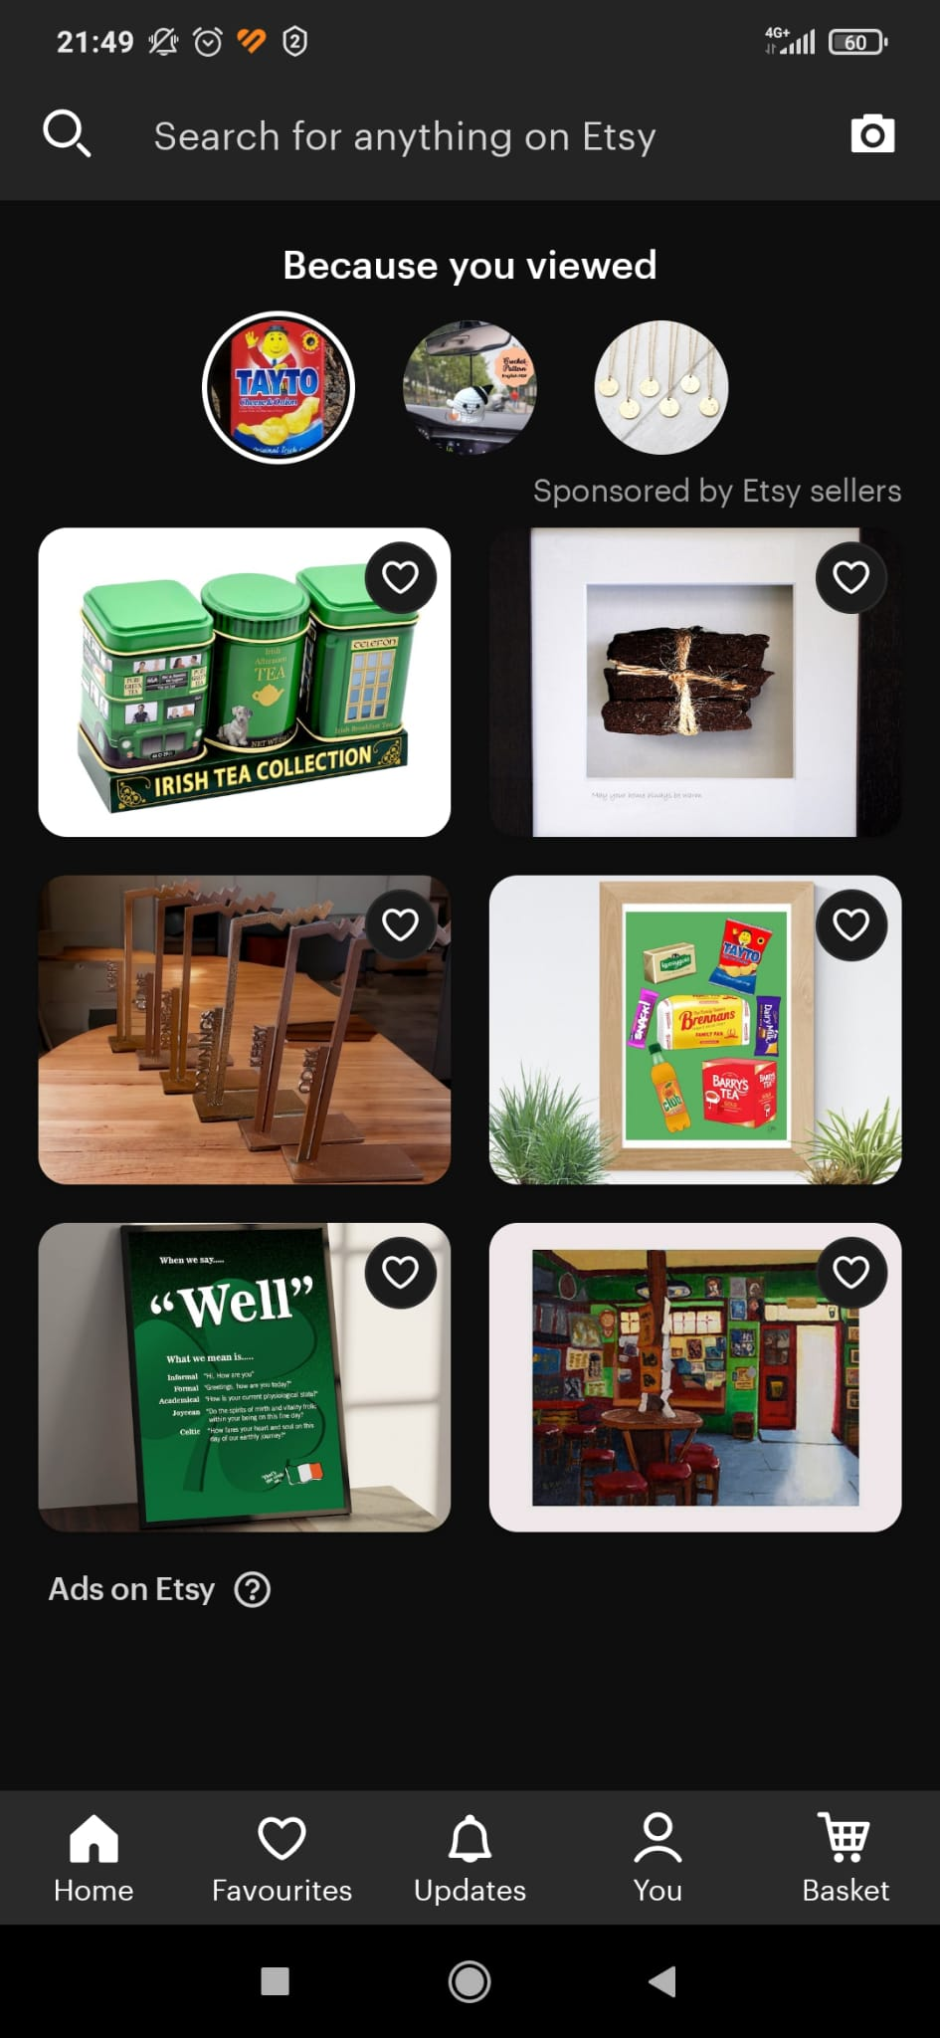
Case Studies on Existing Application
- Made Me (Don`t provide Forum for Artisans;
limited listing of product categories)
- Folksy (Online registration for craft makers,
not representing Artisans on map,
Not having Forum, only direct chat to artisans.)
- Etsy (Online registration ,no map representation
of local artisans, no forum for artisans)

Slide 9
Chosen Research and Development Methodologies
- The Mixed Research methodology was used for the project, with is mix of:
- Quantitative research
- Qualitative research
- Rapid Application development using Prototyping was chosen for current project
- quick feedback from potential users
- usable parts of software can be represented quickly
- suitable to low budget, low timing projects with reduction of risks which exactly the case of proposed project

Slide 10
Technologies and Implementation
Android Studio
Main development tool for android applications
Kotlin
JetBrains (2011)
Well documented and supports Java legacy
Automatically makes application concurrent
Google Firebase
Building scalability for mobile application
Huge platform, Easy to Implement,
Follows data protection standards, not storing credentials of users in local database (increase security)
3rd Party Digital Wallet
Secure payment without storing financial transaction details in database.

Slide 11
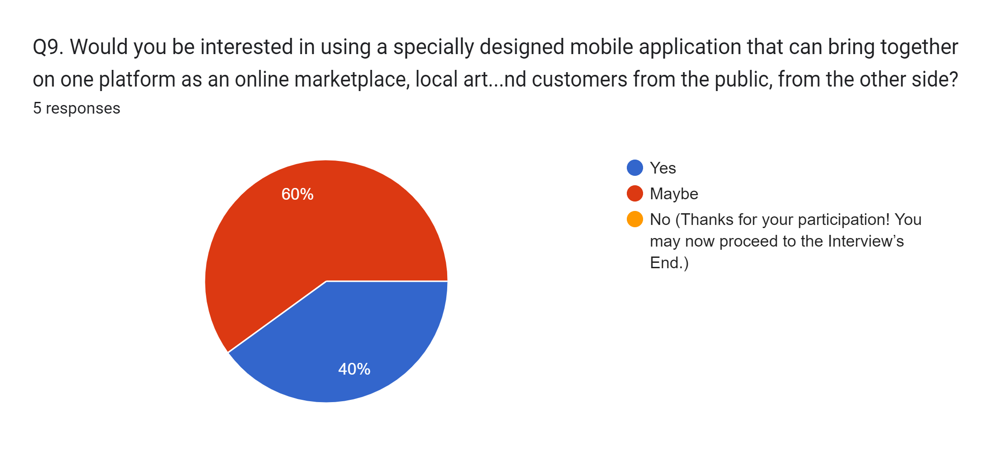
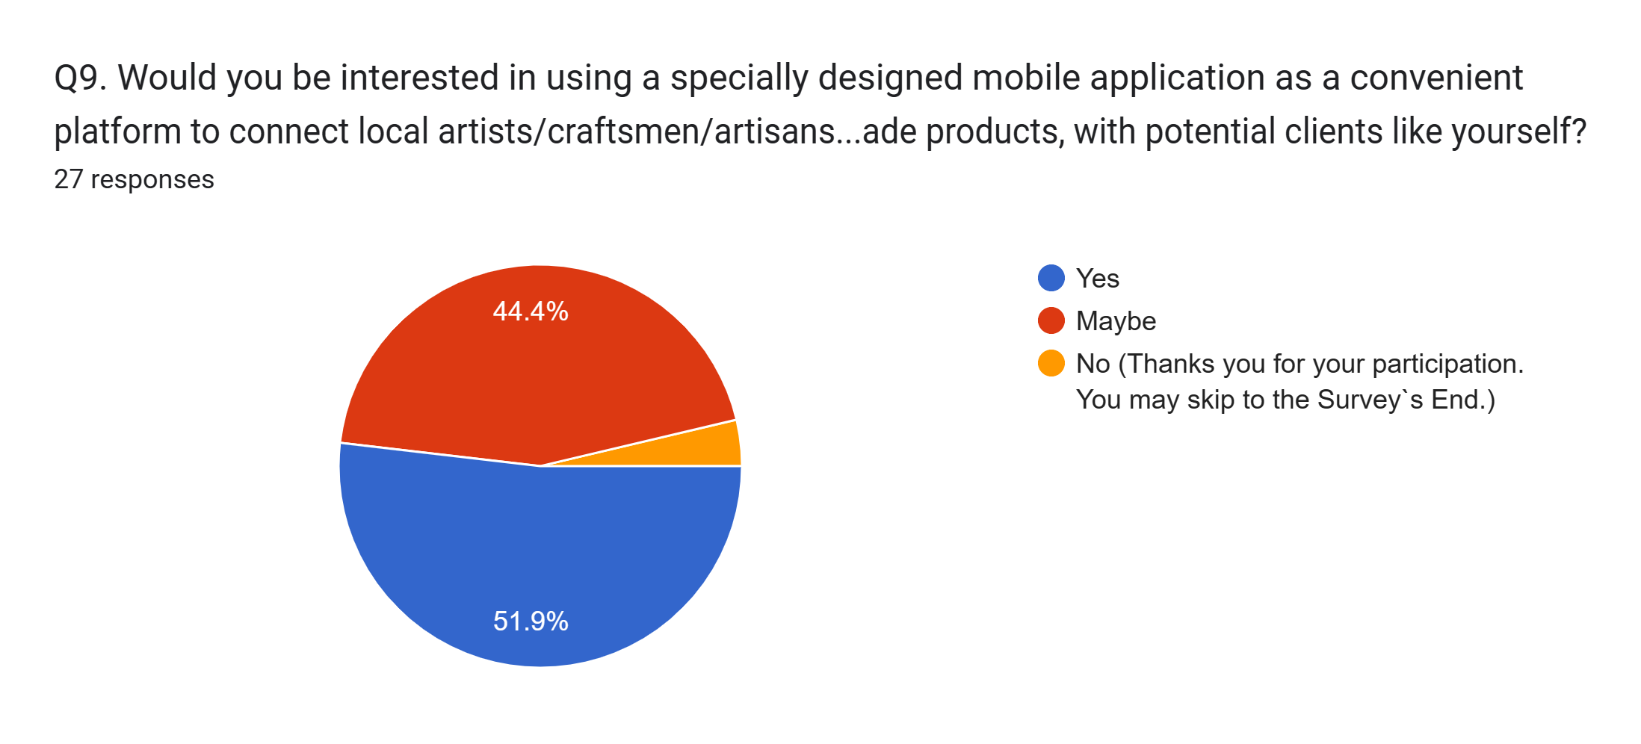
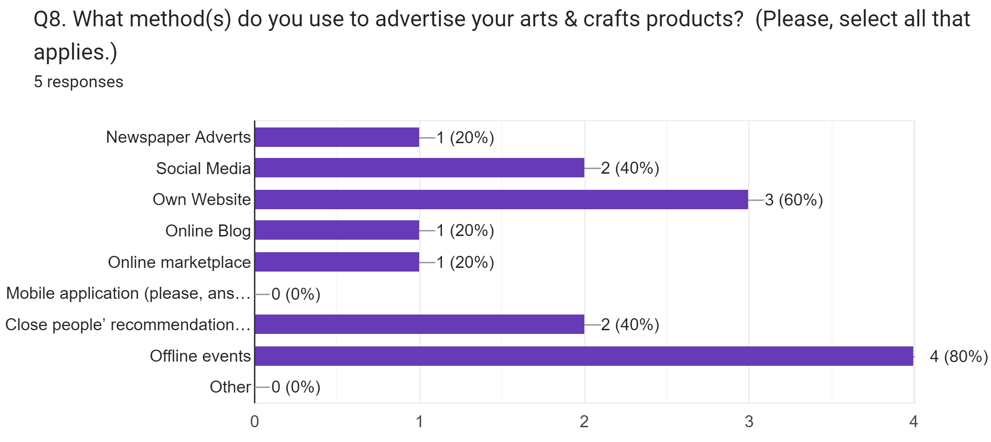
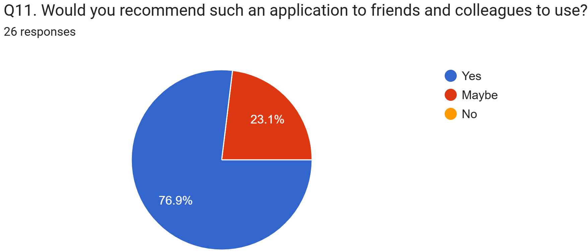
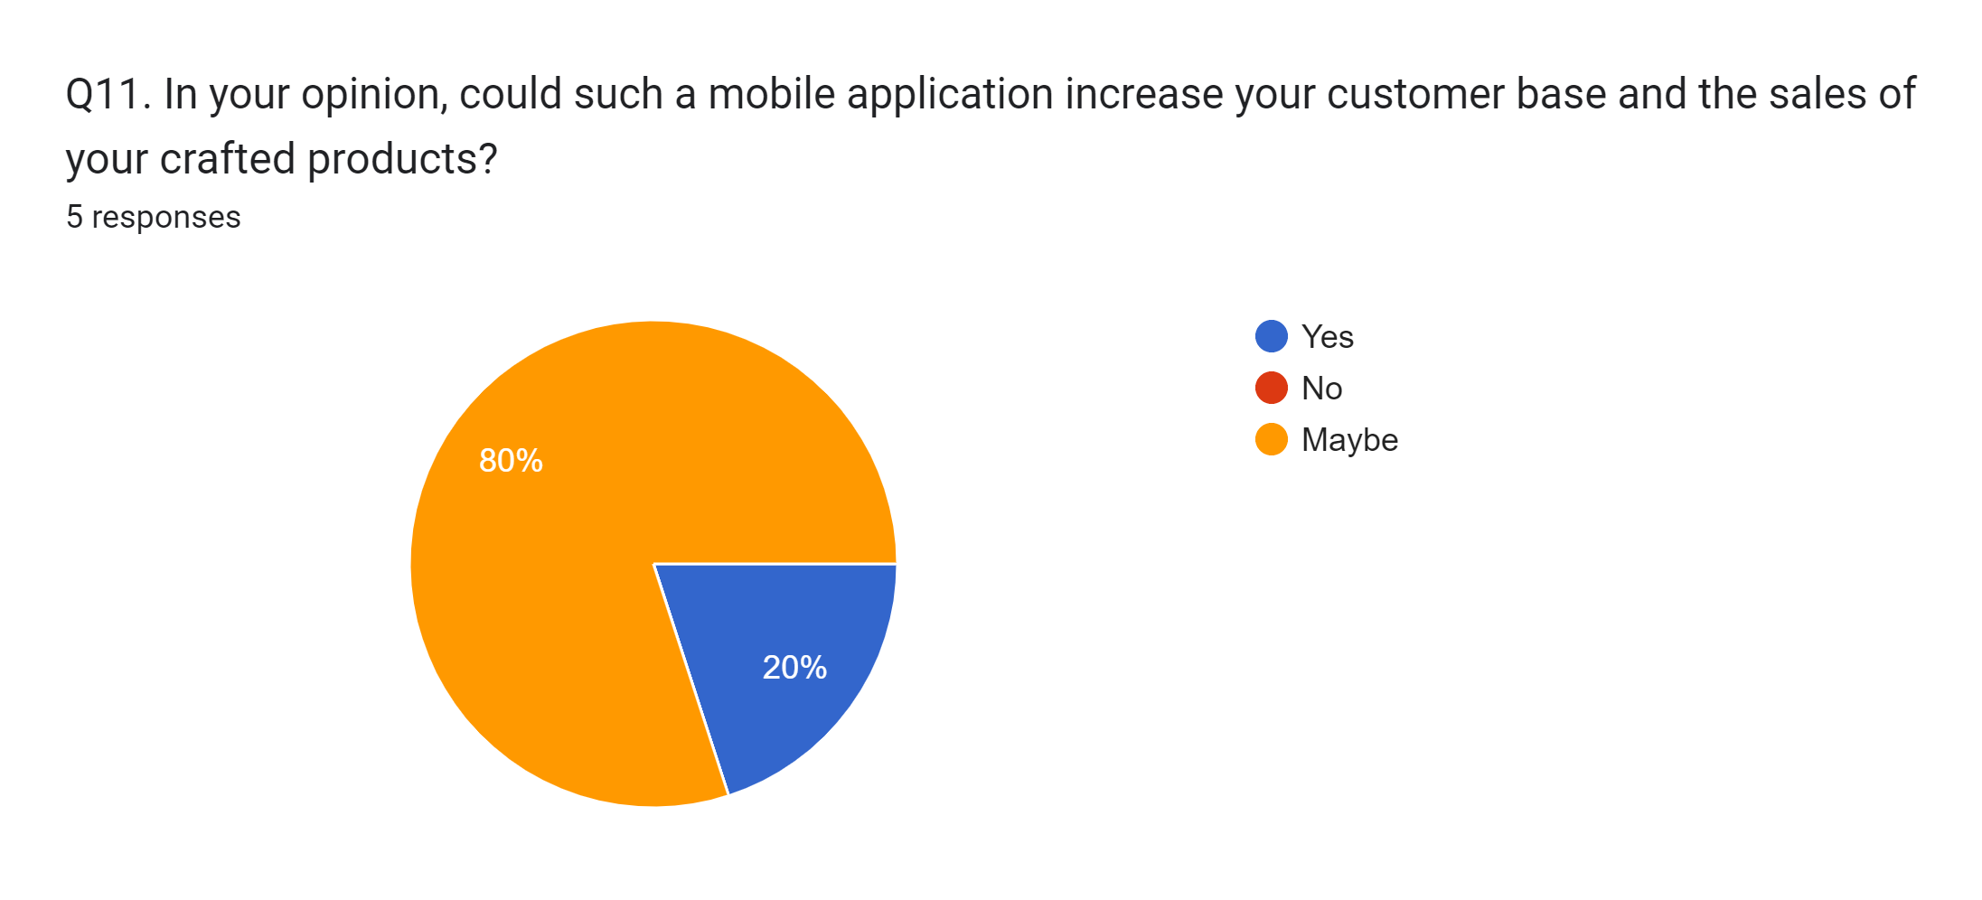
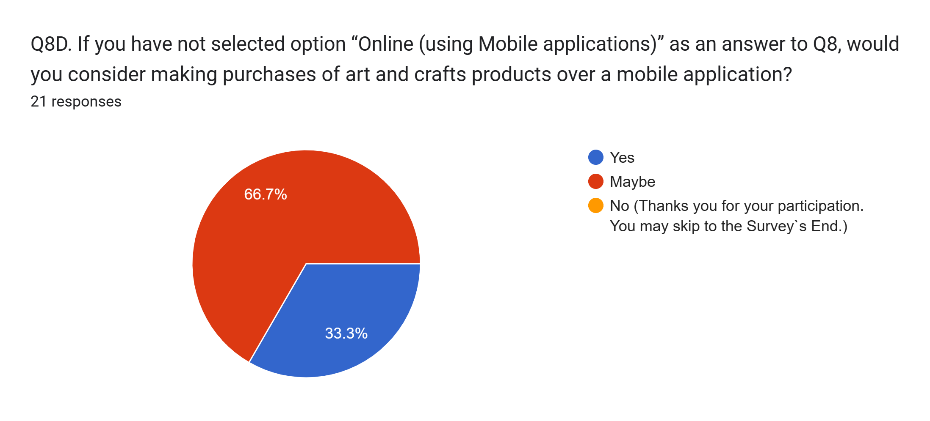
Local Artisans Structured Interview Results
General Public Survey Results
Was used Google Forms as a tool, 5 participants answered to the survey, that was performed at November 23
Was used Google Forms as a tool, 32 participants answered to the survey, that was performed at November 23

Slide 12
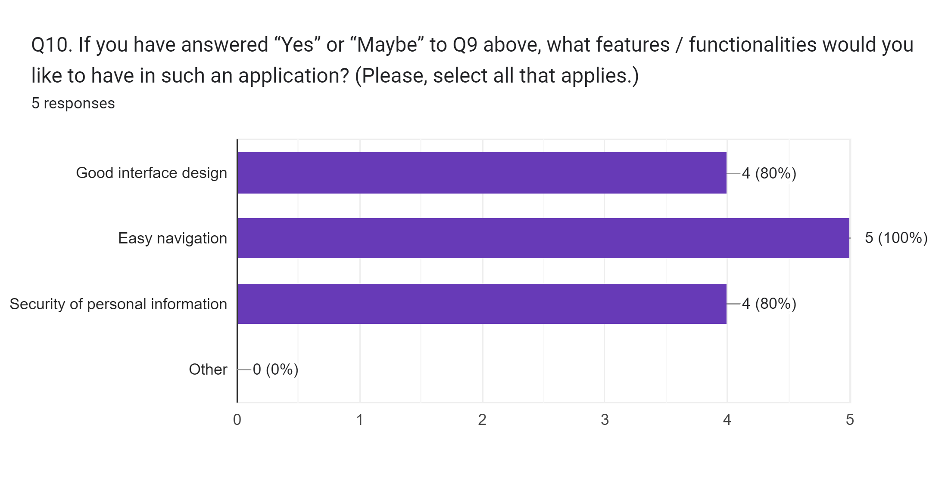
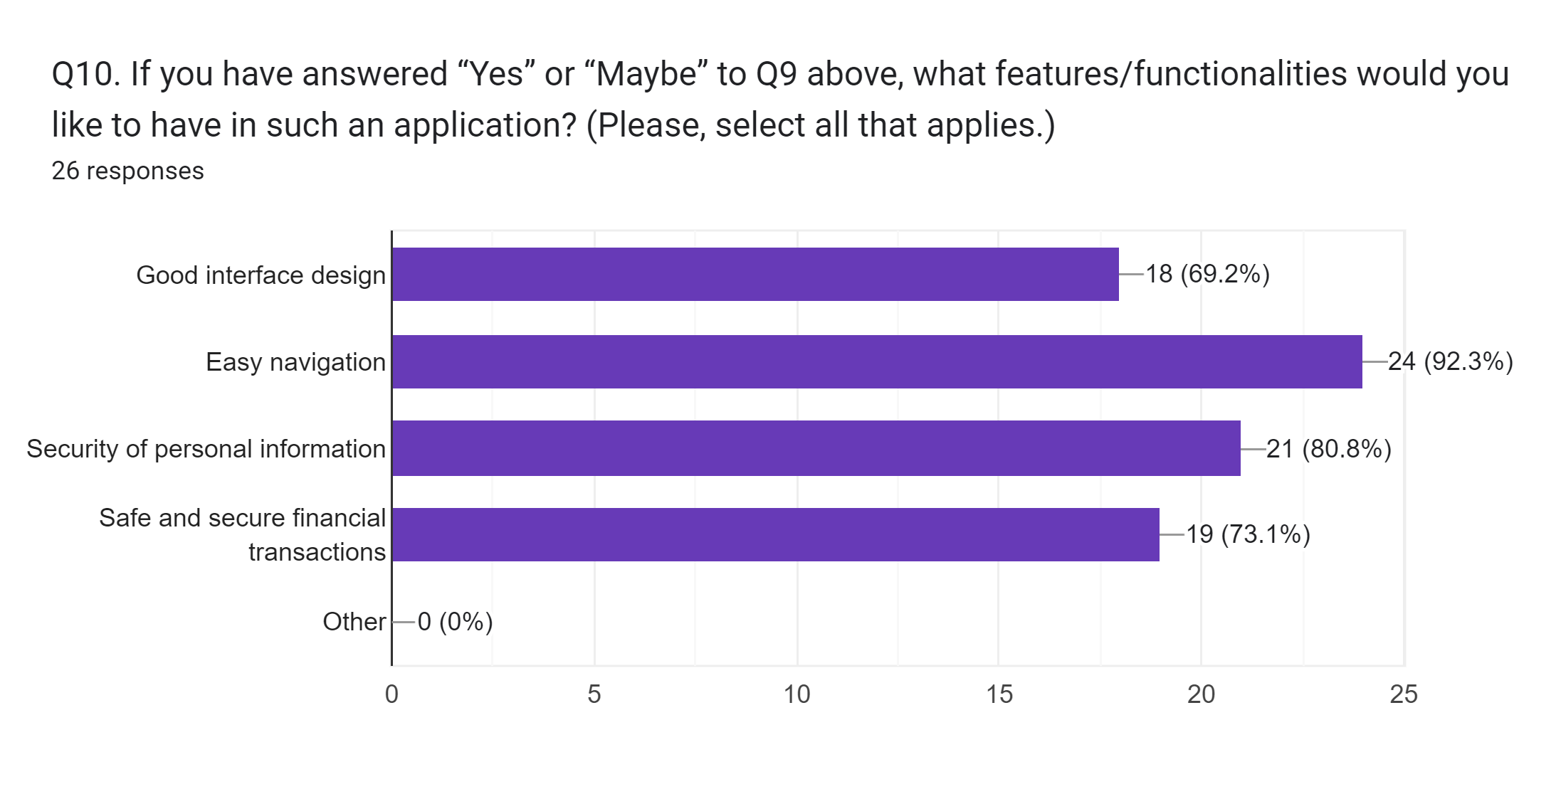
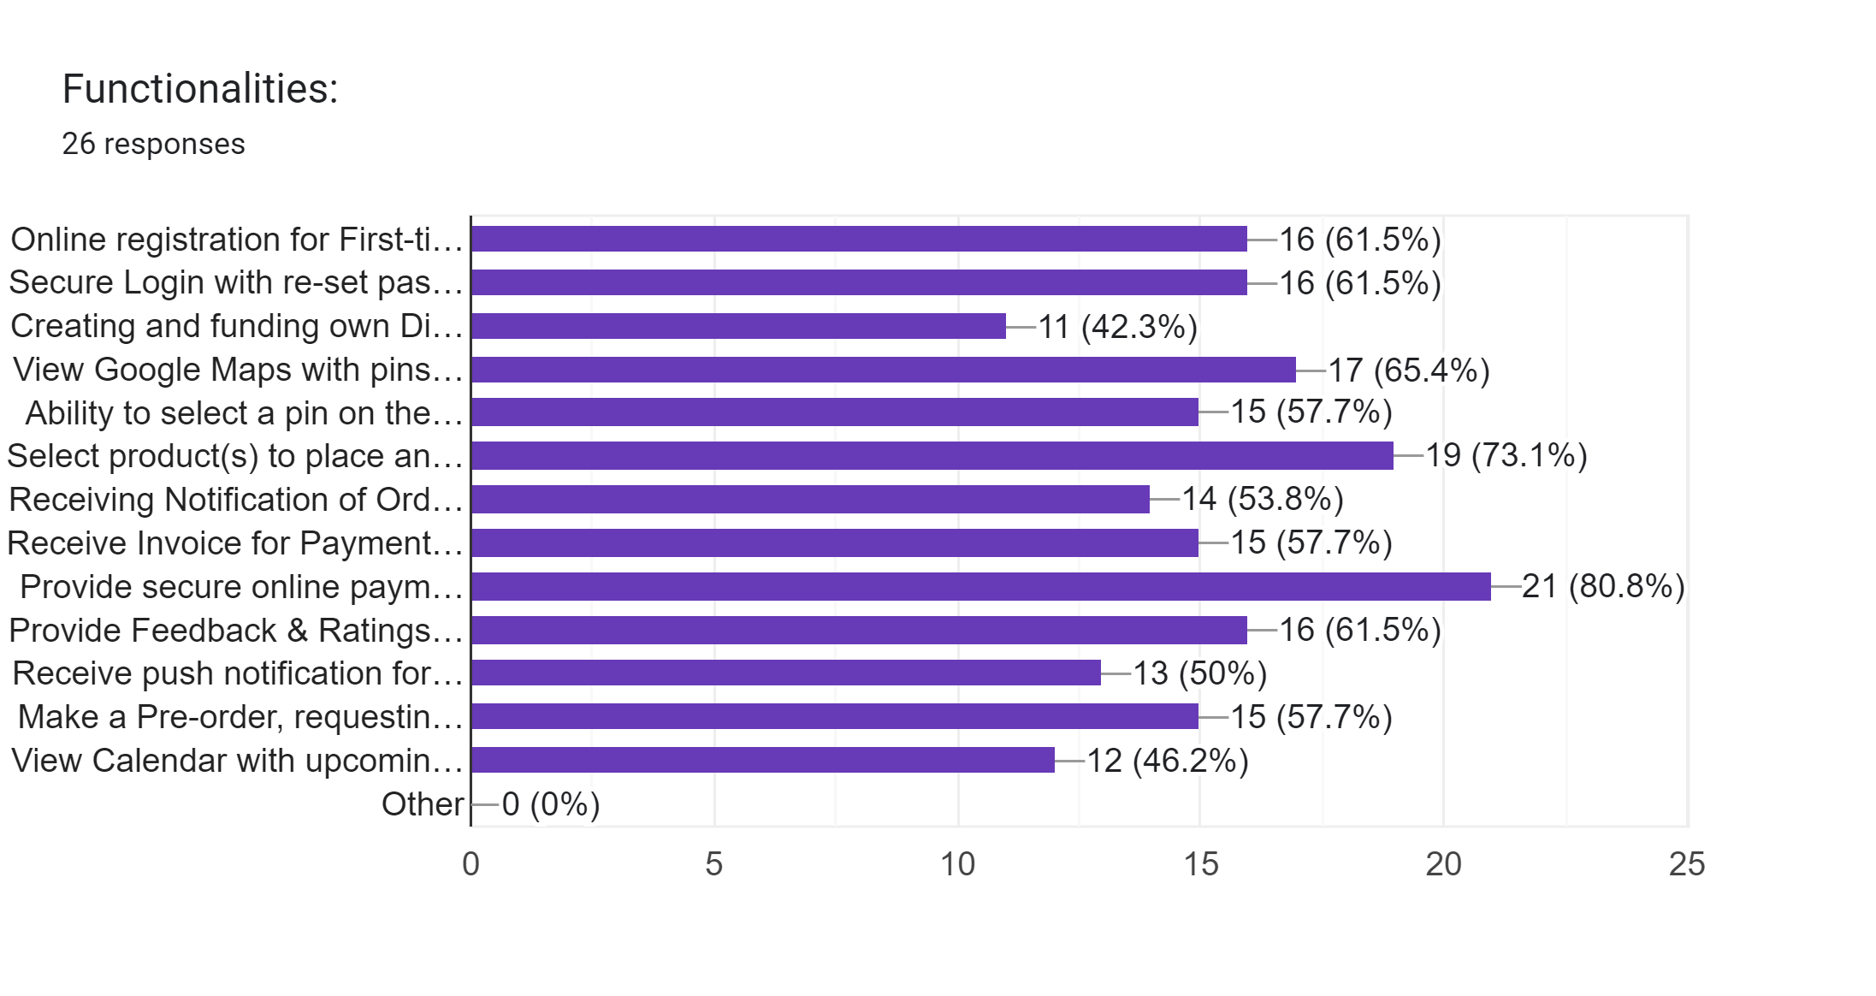
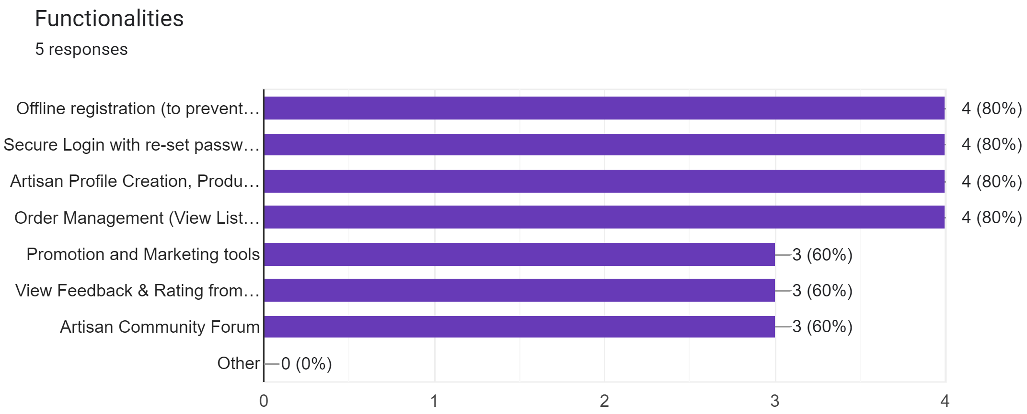
Local Artisans Structured Interview Results
General Public Survey Results

Slide 13
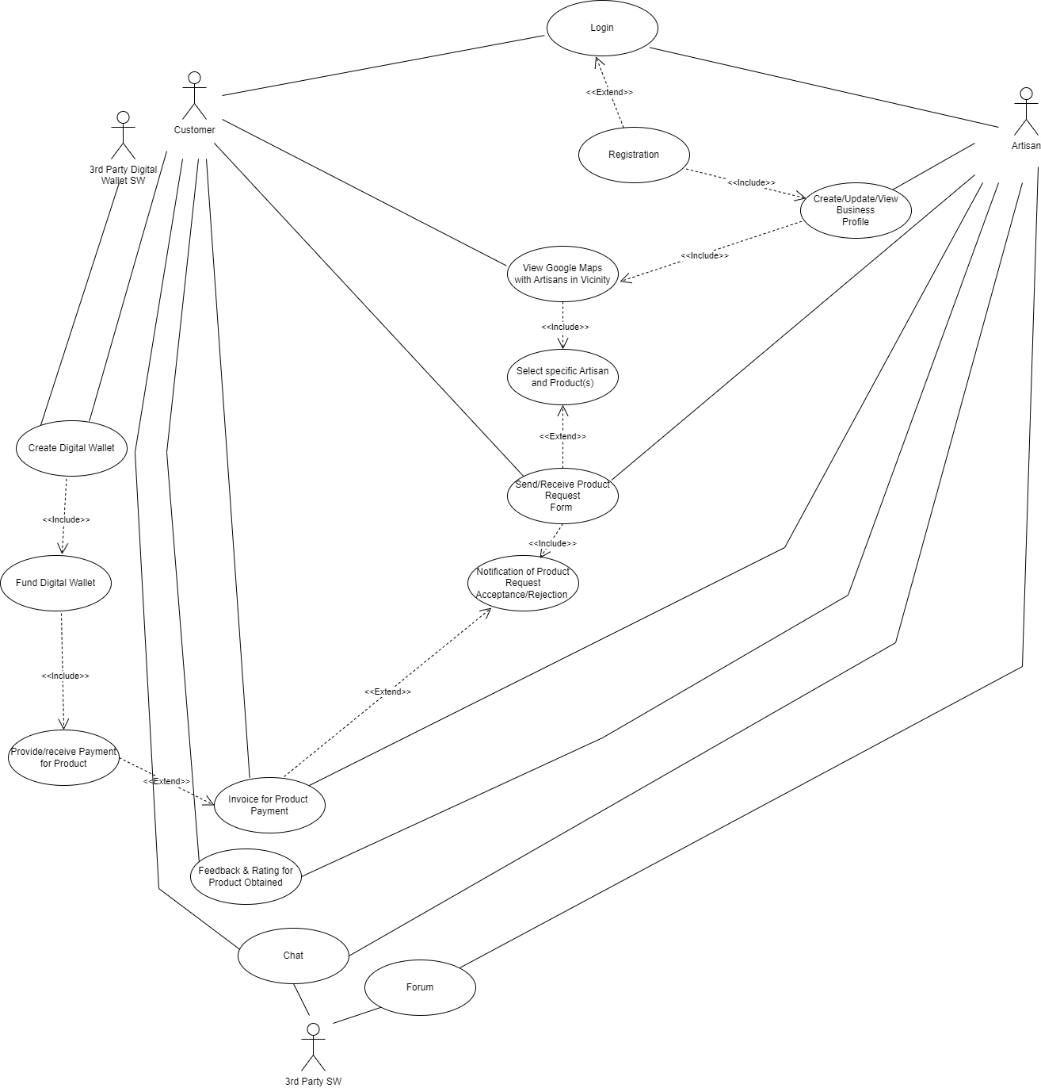
Conceptual Model: Use Case Diagram
- Actor – subject, object or another system that out of current and interacts with current one
- Use Case – representation of functionalities within the system
- <<include>> and <<extend>> - represents relations of functionalities.

Slide 14
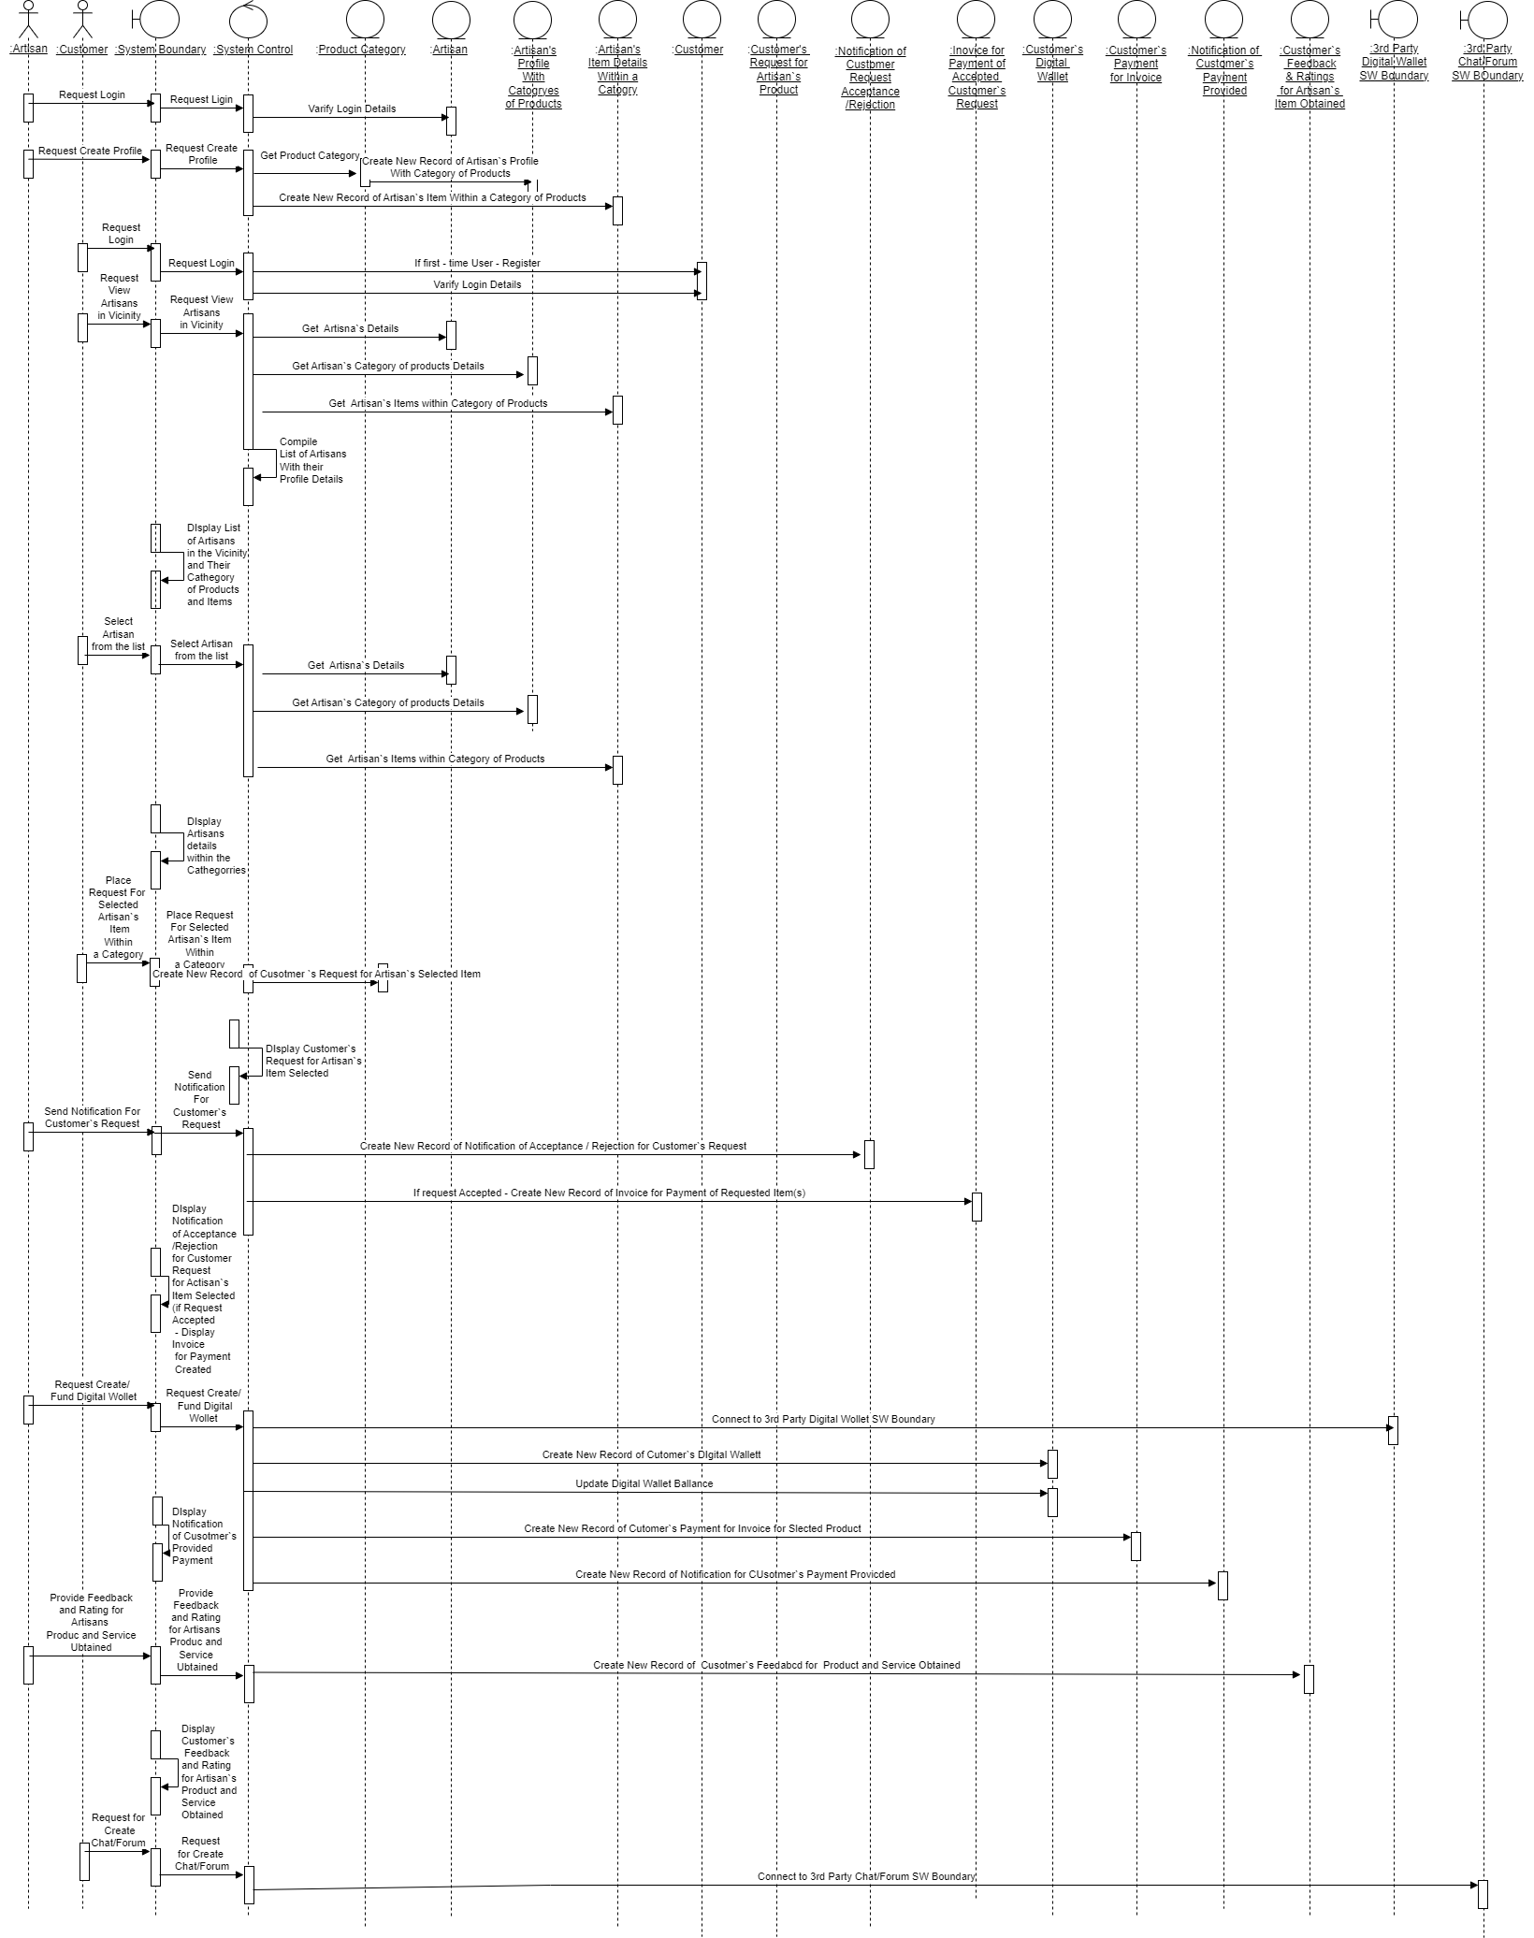
Conceptual
Model: Sequence
Diagram
- shows changes of object state within time
- helps to understand flow and processing of the app
Actor – sends message to the system

Slide 15

Conceptual
Model: Sequence Diagram
- Boundary class connects actors by providing interface
- Control class contains logic of the system
- Entity classes contains data and processed data

Slide 16
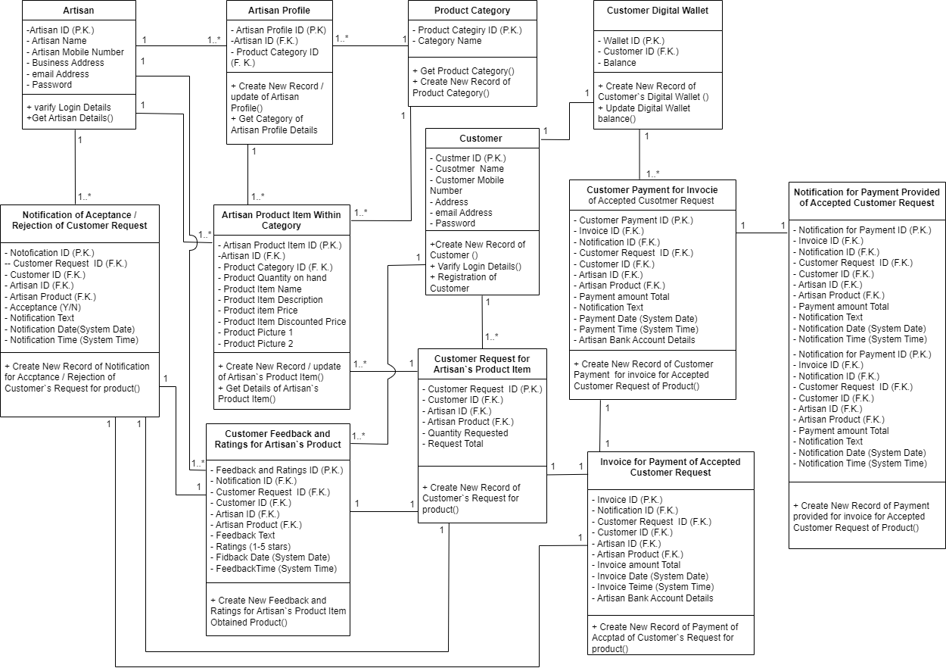
Conceptual Model: Object Class Diagram
Shows relationships between classes, interfaces and objects
Each class having its own attributes and methods

Slide 17
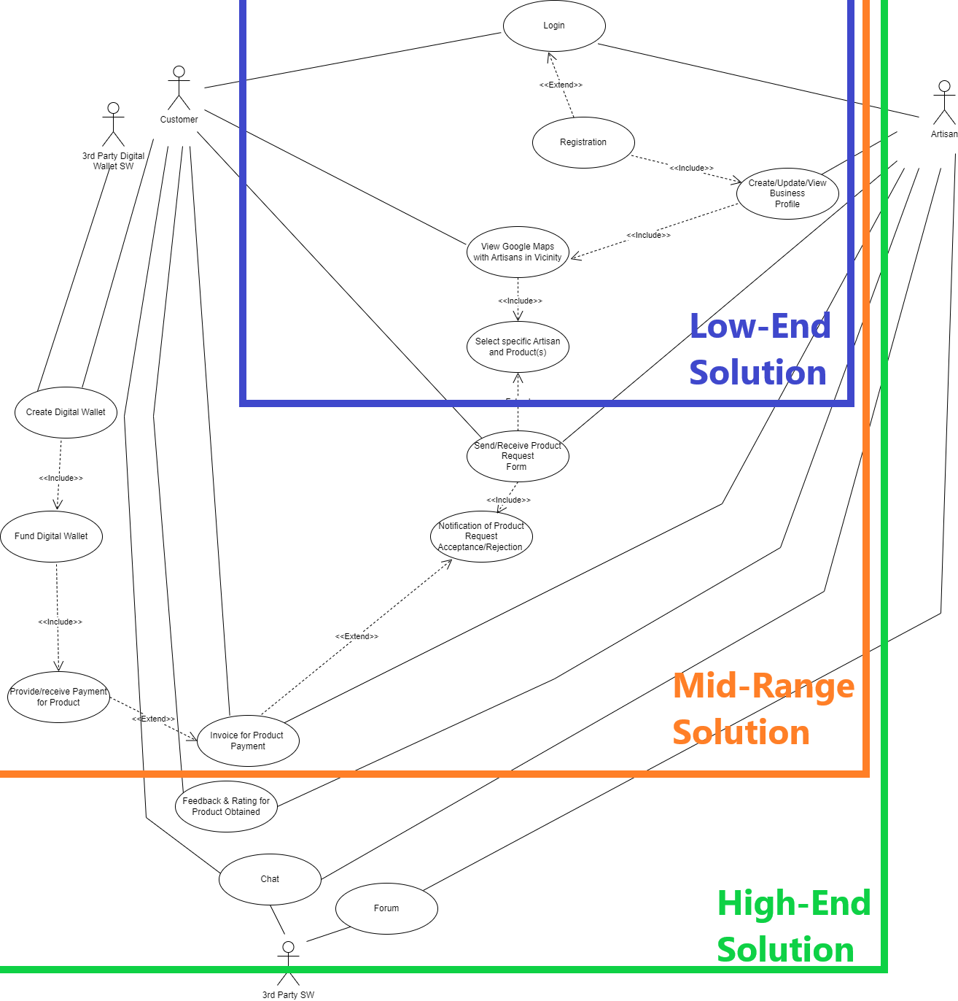
Alternate Design Solutions
- The Mid-Range Solution chooses to be developed in the current project. It will have represented features for Low-End Solution, plus:
Crating Digital Wallet (Founding Digital Wallet, Provide/Receive payment for Product)
Send/Receive Request Form (Notification of Product Request Acceptance / Rejection)
Invoice for Product Payment
The High-End Solution will be consider for future iterations within the project.

Slide 18
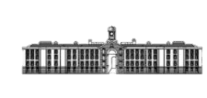
Thank you
Valentin Gnidyi 3054010
GRIFFITH COLLEGE

